Slide 1

Strategies in Designing Algorithms
Presented by:
Elizer Ponio Jr.
Department of Computer Science
College of Computing and Information Technologies

Slide 2
Outline
Algorithm and Strategy
Brute Force Approach
Divide and Conquer Approach
Greedy Approach
Dynamic Programming Approach

Slide 3

Algorithm and Strategy
One very important aspect of problem-solving is devising good strategies.
Definition of Strategy
A strategy is an approach (or a series of approaches) devised to solve a computational problem.
Definition of Algorithm
An algorithm is a sequence of computational steps that transform the input to an output.

Slide 4
Algorithm and Strategy
There are many strategies for designing algorithms
Brute Force
Divide and Conquer
Greedy Method
Dynamic Programming

Slide 5
Brute Force Approach
This is the simplest approach where you exhaustively try all possible solutions and select the best one.
A very straightforward approach but can be inefficient for large problem sizes due to its time complexity.

Slide 6
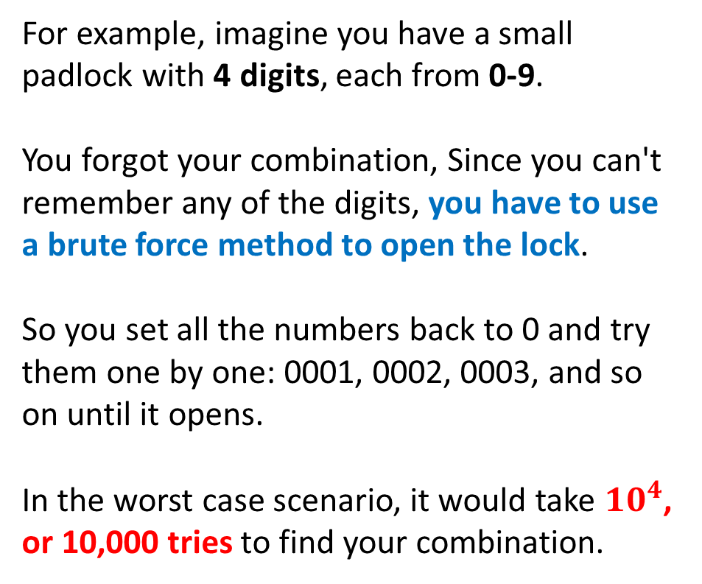
Brute Force Approach
For example, imagine you have a small padlock with 4 digits, each from 0-9.
You forgot your combination, Since you can't remember any of the digits, you have to use a brute force method to open the lock.
So you set all the numbers back to 0 and try them one by one: 0001, 0002, 0003, and so on until it opens.
In the worst case scenario, it would take ${10}^{4}$, or 10,000 tries to find your combination.

Slide 7
Divide and Conquer Approach
A divide and conquer algorithm is a strategy of solving a large problem by
Breaking the problem into smaller sub-problems
Solving the sub-problems
Combining them to get the desired output.

Slide 8
Divide and Conquer Approach
The merge sort algorithm uses the divide and conquer approach where:
1. An array is divided into two halves
2. Each subpart is then divided recursively until we get the individual elements
3. The elements are then combined in a sorted manner. Hence, we conquer and combine

Slide 9
Greedy Approach
A greedy algorithm is an approach for solving a problem by selecting the best option available at the moment.
It doesn't worry whether the current best result will bring the overall optimal result.
The algorithm never reverses the earlier decision even if the choice is wrong

Slide 10
Greedy Approach
One examples is Dijkstra’s Algorithm to find the shortest distance between two vertices
The algorithm uses a greedy approach in the sense that we find the next best solution/path hoping that the end result is the best solution for the whole problem.

Slide 11
Dynamic Programming Approach
Dynamic Programming is an approach for solving a problem by breaking down a problem into smaller overlapping sub-problems and stores the results of sub-problems to avoid redundant calculations

Slide 12
Dynamic Programming Approach
Dynamic programming works by storing the result of subproblems so that when their solutions are required, they are at hand and we do not need to recalculate them.
This technique of storing the value of subproblems is called memoization. By saving the values in the array, we save time for computations of sub-problems we have already come across.

Slide 13
Dynamic Programming Approach
A classic real-world example of dynamic programming is the "Fibonacci sequence" problem.
The Fibonacci sequence is a series of numbers where each number is the sum of the two preceding ones, usually starting with 0 and 1.
So the sequence goes: 0, 1, 1, 2, 3, 5, 8, 13, 21, and so on.

Slide 14
Dynamic Programming Approach
When you want to find the nth Fibonacci number, a recursive approach can be used, where you calculate each number by adding the two preceding numbers.
However, this recursive approach can become inefficient very quickly because it recalculates the values of the Fibonacci sequence multiple times.

Slide 15
Dynamic Programming Approach
In Dynamic Programming, instead of recalculating the Fibonacci numbers every time, each Fibonacci number is stored in an array or table for future use.
This approach reduces redundant calculations and improves the time complexity of the algorithm significantly, making it much faster, especially for large values of n.

Slide 16
References
https://medium.com/swlh/strategies-in-algorithm-design-17029c7beb57
https://www.programiz.com/dsa/greedy-algorithm
https://www.programiz.com/dsa/divide-and-conquer
https://www.programiz.com/dsa/dynamic-programming
https://www.freecodecamp.org/news/brute-force-algorithms-explained/

